Slide 1
Optical analysis of different glass types
-Ridhesh Goti (19STS030)

Slide 2

Dispersion of light
Light disperse through medium
Wavelength dependency of the refractive index
It depends on the material types/glass type
In general dispersion relation is given by cauchy formula,
Here this relation is depended on only certain range of wavelengths. Within that range it is called as normal dispersion.

Slide 3
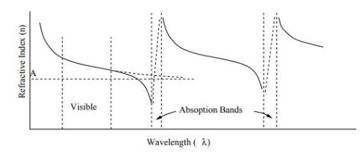

Another type, Anomalous dispersion. At the edge of that region the RI decreases rapidly because of absorption.
In dielectric medium certain range of wavelengths are absorbed. After that there is one peak due to resonance.
Final equation due to electric field effect of light on medium is,

Slide 4

Relation trends :
(1) Refractive index of substance increases with decreasing of wavelength
(2) The rate of increase becomes greater at shorter wavelength.
Abbe number (measurement of dispersion):
Low abbe number means that dispersion is high and vice versa.
Nd, Nf, Nc are refractive index of material at wavelengths of Fraunhofer D,F and C lines(589.3 nm, 486.1 nm, 656.3 nm respectively).
Flint glass has abbe number V < 50 and crown glass has V > 50.

Slide 5
Find the dispersion relation through ZEMAX
In dispersion theory, different wavelengths have different refractive index.
There are experimentally verified constants values for all dispersion formula and give the relation between refractive index and wavelengths. There are some catalogs made by manufacturer of glass which provides the details of the glass.
These catalogs provide the thermal and dispersion relation details.
Example of catalogs : ohara, hoya, birefrin-gent, hikari, sumita, misc, infrared
Extension of the catalog is AGF which is basically ANSII file. It could open with notepad with texts.

Slide 6
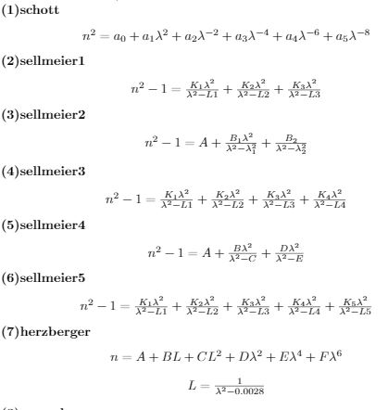
Dispersion formulas

Slide 7
How to read catalogs (N-BK7)
NM N-BK7 2 517642.251 1.5168 64.17 0 1
GC step 0.5 available
ED 7.100000 8.300000 2.510000 -0.000900 0
CD 1.039612120E+00 6.000698670E-03 2.317923440E-01 2.001791440E-02
1.010469450E+00 1.035606530E+02 0.000000000E+00 0.000000000E+00
TD 1.860000E-06 1.310000E-08 -1.370000E-11 4.340000E-07 6.270000E-10
1.700000E-01 2.000000E+01
OD 1.0000 1.0000 0.0000 1.0000 2.3000 2.3000
LD 3.00000E-01 2.50000E+00
IT 3.00000E-01 5.00000E-02 2.50000E+01
IT 3.10000E-01 2.50000E-01 2.50000E+01
...................................................................

Slide 8
Python programming
With using of python, data extraction from catalogs becomes easy.
After getting input data of glass name from user, python runs the code through loops and logic codes and get data and all constants.
Using these constants and data, we can get plots and relation for dispersion and thermal analysis.

Slide 9
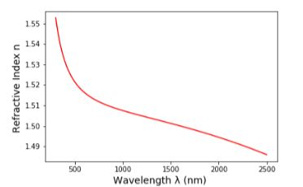
Dispersion data for N-BK7 (schott) glass
Name : N-BK7
Wavelength range : 300 nm to 2500 nm
RI for N-BK7 at 1060 nm wavelength is 1.5066875568966998.
From the equation of abbe number, the value for N-BK7 is 64.13319920721142.

Slide 10
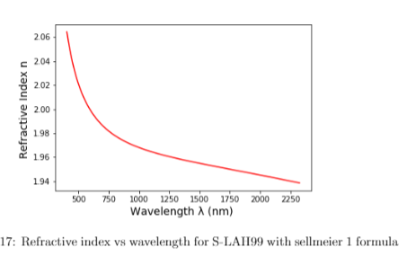
Dispersion data for S-LAH99 (ohara) glass
The curve has negative slope and refractive index is decreasing with increasing of wavelength.
Also formula is valid only for certain range of wavelengths. The range is 404 nm to 2325 nm.
Refractive index of S-LAH99 at 1060 nm wavelength is 1.9659499406949175
From the equation of abbe number , the value for S-LAH99 is 29.11920404841508.

Slide 11
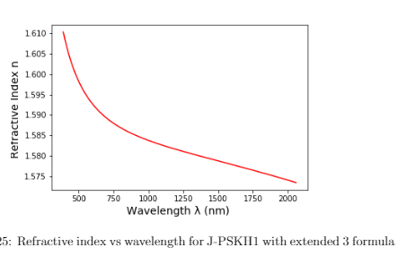
Dispersion data for J-PSKH1 (hikari) glass
The curve has negative slope and refractive index is decreasing with increasing of wavelength.
Also formula is valid only for certain range of wavelengths. The range is 388 nm to 2058 nm.
Refractive index of J-PSKH1 at 1060 nm wavelength is 1.5830354695353313
From the equation of abbe number, the value
for J-PSKH1 is 67.86486866978349

Slide 12
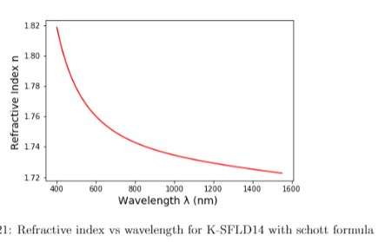
Dispersion data for K-SFLD14 (sumita) glass
Name : K-SFLD14
Range : 400 nm to 1550 nm
Refractive index of K-SFLD14 at 1060 nm wavelength is 1.7327813923080453
Abbe number : 26.48690066758293

Slide 13
Application of data
Using this data we can get precise value of aberration which further uses in reducing the aberration.
Uses in filter by putting screen/image plane at specific distance which varies with wavelengths.

Slide 14
Thermal analysis
The refractive index of glass changes with temperature due to its intrinsic properties.
It also depends on pressure of surroundings so that would give the two part of refractive index (1)Absolute refractive index and (2) Relative refractive index.
For thermal analysis, the data is given in the catalogs for appropriate constants. The rate of change of absolute refractive index is given by,

Slide 15
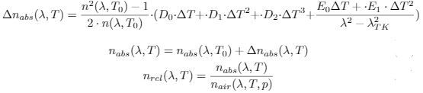
T0 is reference temperature which is given in catalogs. All the RI data from catalogs are with condition of pressure as 103250 Pa and reference temperature T0.
Another set of equations are given by,

Slide 16



Refractive index of air at given conditions
Above equations are for refractive index of air with different temperature and pressure.

Slide 17


From the above equation, it gives the change of rate of relative RI with temperature.
Refractive index of air is given at different conditions.
The final equation gives the relation between refractive index vs temperature.

